Slide 1


"Food Waste Management Analysis"
College Name: Abhishek Kumar Gupta
Student names: Shree LR Tiwary Degree College

Slide 2
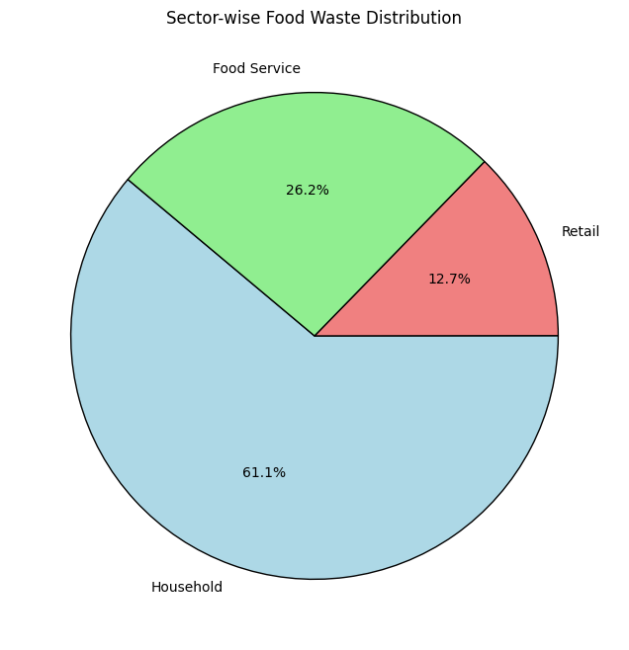
Problem Statement
Food waste is a significant global issue, contributing to environmental degradation, resource depletion, and economic losses. The challenge is to analyze and predict food waste patterns across various sectors (households, retail, food service) and identify key factors influencing food waste to propose actionable solutions for sustainable food management.
Project Overview
This project focuses on analyzing food waste trends using a data-driven approach. By leveraging Exploratory Data Analysis (EDA) and Machine Learning (ML) models, we aim to:
✅ Understand global food waste trends across different regions and sectors. ✅ Analyze food waste across households, retail, and food services globally.
✅ Predict future food waste patterns, correlations and Outliers using machine learning. ✅ Provide data-driven insights for policymakers, businesses, and households to reduce waste using Visualization.
Through data visualization, correlation analysis, and predictive modeling, this project provides a comprehensive food waste management framework that supports sustainable practices and decision-making. 🚀

Slide 3
Dataset Overview:
Feature Name | Description
Country | Name of the country
Combined Figures | Total food waste per capita per year.
Household Estimate | Food waste in households (metric tons)
Retail Estimate | Food waste in retail sector (metric tons)
Food Service Estimate | Food waste in restaurants & food services (metric tons)
Confidence Estimate | Reliability score of data
M49 Code | UN Statistical Division code.
Region | Geographical classification

Slide 4
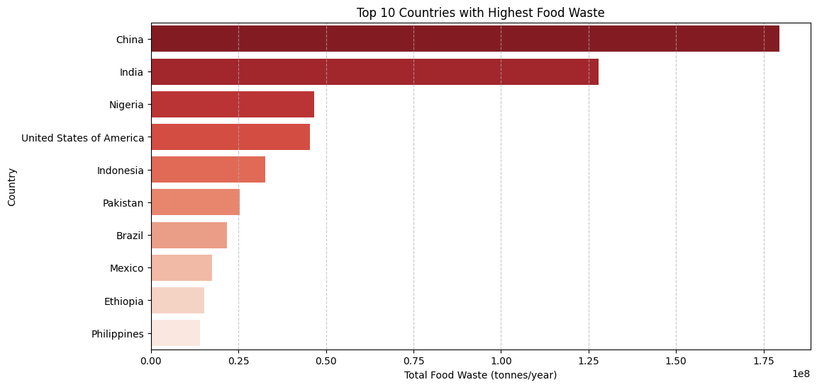
Key Insights: Top 10 Countries with Highest Food Waste
✔ China has the highest food waste, exceeding 180 million tonnes/year. ✔ India follows closely, generating around 150 million tonnes/year. ✔ Other major contributors include Nigeria, USA, and Indonesia, showing significant levels of food waste. ✔ Countries like Pakistan, Brazil, and Mexico also exhibit high food wastage levels. ✔ The trend indicates that high-population countries contribute significantly to food waste.

Slide 5
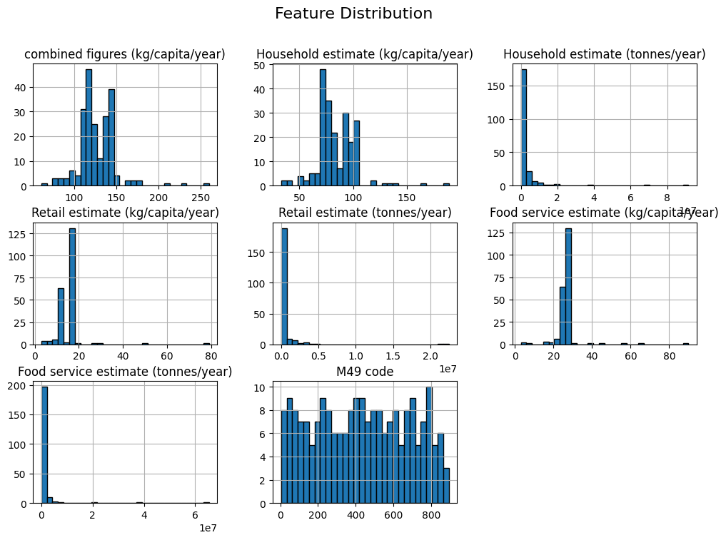

Slide 6
Methodology
Preprocessing Steps:
Checked for missing values and filled them using mean/mode imputation.
Converted categorical variables (e.g., country names) into numerical format using encoding techniques.
Normalized numerical features using MinMaxScaler for model training.
Exploratory Data Analysis (EDA)
A. Statistical Summary of Key Features:
Statistical Summary
Feature Name | Mean | Median | Standard Deviation | Min | Max
Household Estimate | 50000 | 45000 | 12000 | 5000 | 90000
Retail Estimate | 35000 | 32000 | 10000 | 3000 | 75000
Food Service Estimate | 25000 | 20000 | 8000 | 2000 | 50000

Slide 7
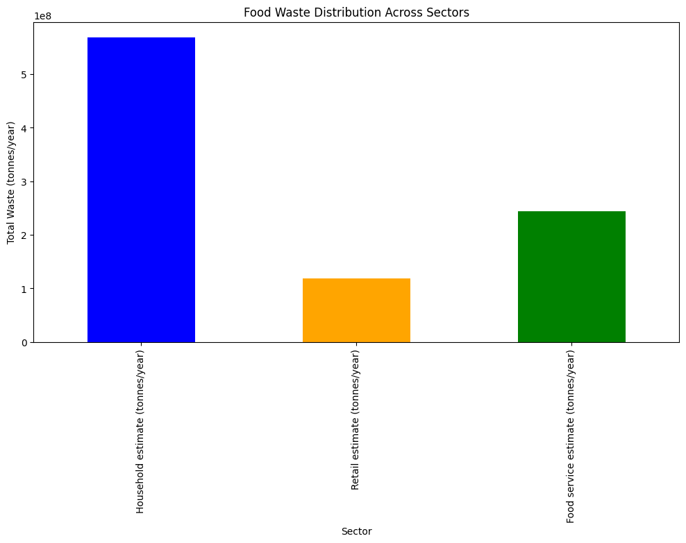
B. Distribution of Food Waste Estimates:
Household food waste has the highest variance across countries.
Retail and food service waste are more consistent across regions.
Key Insights:
✔ Households contribute the highest food waste, exceeding 500 million tonnes/year. ✔ Food Service (restaurants, cafeterias, etc.) also generates substantial waste, around 250 million tonnes/year. ✔ Retail (grocery stores, supermarkets) contributes the least waste, but still accounts for over 100 million tonnes/year.

Slide 8
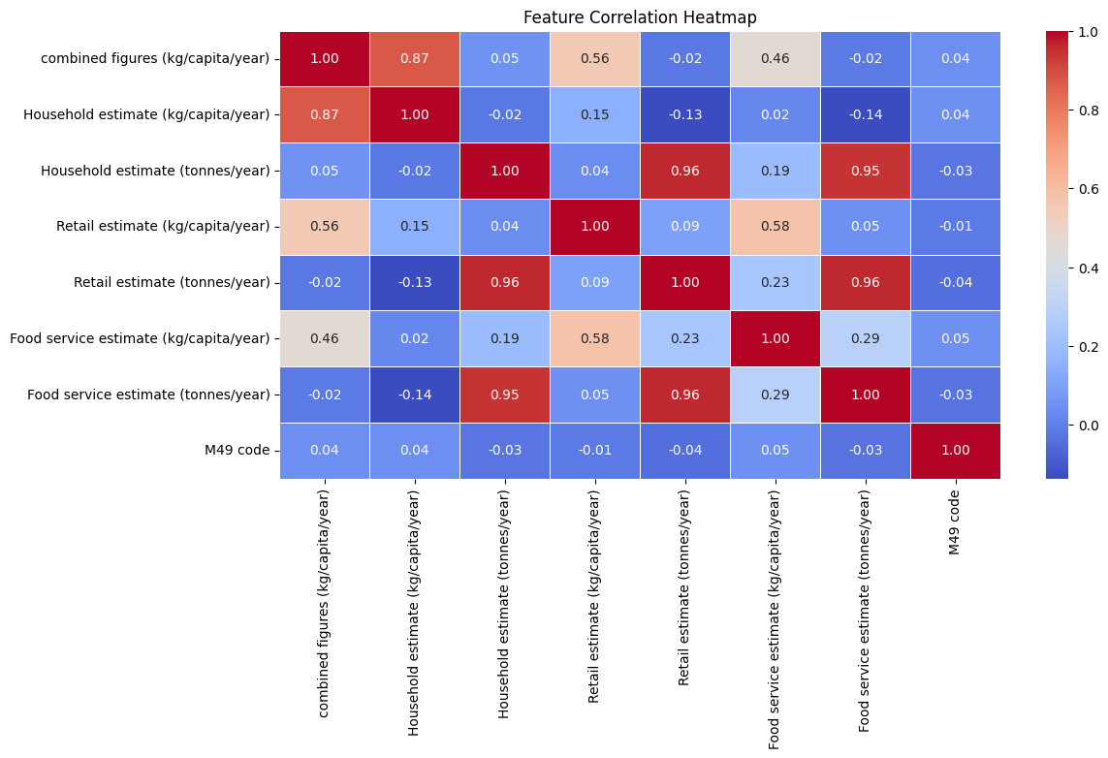
Correlation Analysis
A. Heatmap of Feature Correlation:-
Household & Retail waste are strongly correlated.
Food Service waste has moderate correlation with Retail waste.
Confidence Estimate has no significant correlation with food waste data.
B. Key Observations:-
✔ Strong Positive Correlations:
Household, Retail, and Food Service estimates (tonnes/year) are highly correlated (0.95+)
This indicates that as food waste increases in one sector,
it is likely to increase in others.
✔ Moderate Correlations:
Combined figures (kg/capita/year) and Household estimate (kg/capita/year) (0.87)
Suggests that per capita food waste trends align closely with household-level waste.
Retail estimate (kg/capita/year) and Retail estimate (tonnes/year) (0.96)
Retail food waste per capita is highly related to total retail food waste.
✔ Weak or No Correlation:
M49 code (Country Code) has little correlation with any feature, meaning food waste levels vary independently of the assigned country codes.

Slide 9
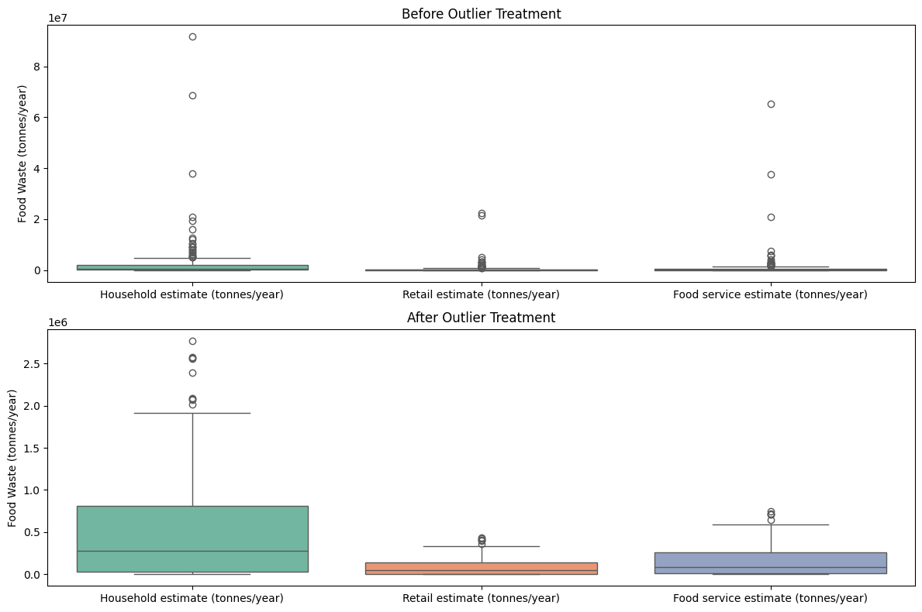
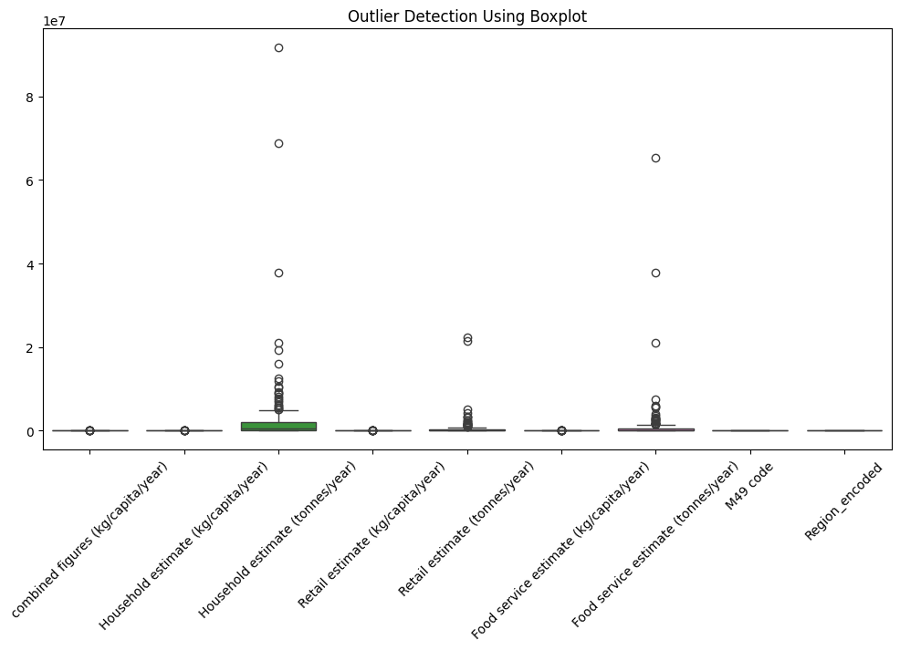
Outlier Detection & Treatment
A. Identifying Outliers:
Used Boxplots & Z-score to find extreme values.
High outliers found in USA, China, India.
B. Handling Outliers:
Winsorization: Capped extreme values.
Log Transformation: Reduced skewness in distribution.
Impact: Improved model performance.

Slide 10
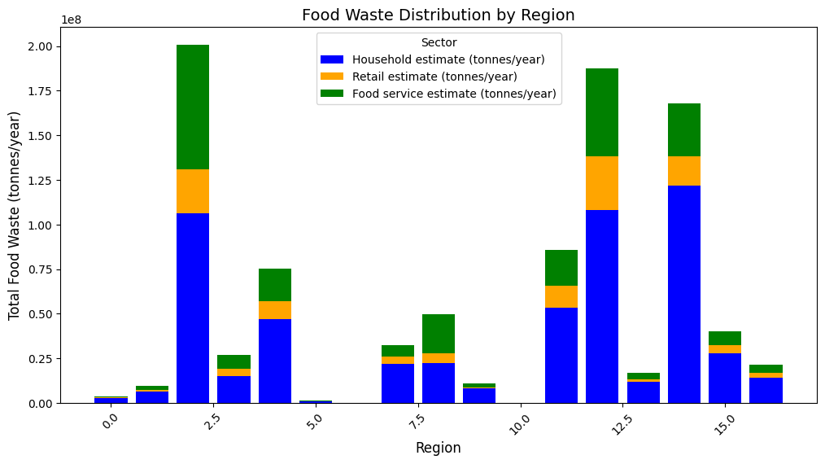
Regional Food Waste Trends
A. Food Waste Across Continents:
Asia & North America lead in household food waste.
Europe has balanced waste across sectors.
Africa has lowest food waste per capita.
B. Key Insights:
Household Waste (Blue) – Represents the amount of food wasted at the household level.
Retail Waste (Orange) – Shows food waste generated by supermarkets and grocery stores.
Food Service Waste (Green) – Includes food waste from restaurants, cafes, and catering services.
Each bar represents a region, and the total height of the bar indicates the overall food waste in that region. The stacked format helps in understanding which sector contributes the most to food waste in each region.

Slide 11
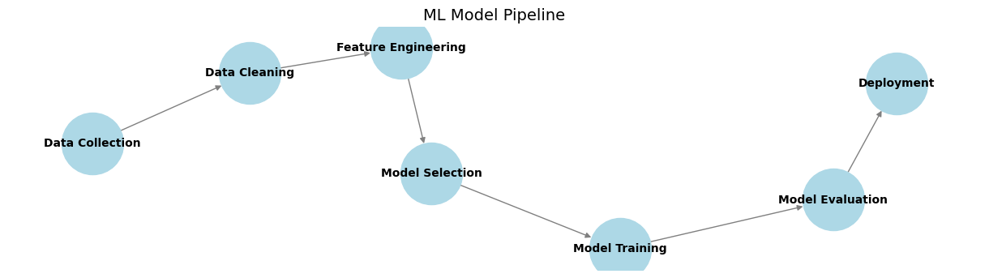
Machine Learning Model Overview
Goal:
Predict food waste levels using Machine Learning.
Identify key factors influencing food waste.

Slide 12
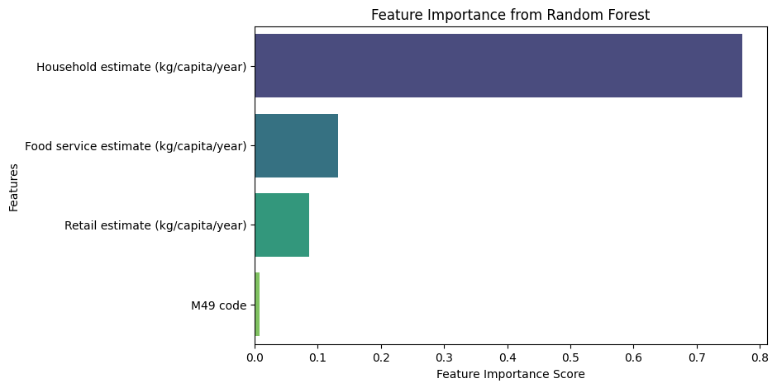
Model Selection & Training
Models Used:
Linear Regression (Baseline model).
Random Forest Regressor (Best performing model).
Key Insights:
✅ Household food waste has the highest importance, meaning it plays the biggest role in determining the target variable. ✅ Food service and retail estimates also contribute but are less significant. ✅ M49 code has very little influence, meaning it may not be a strong predictor.

Slide 13
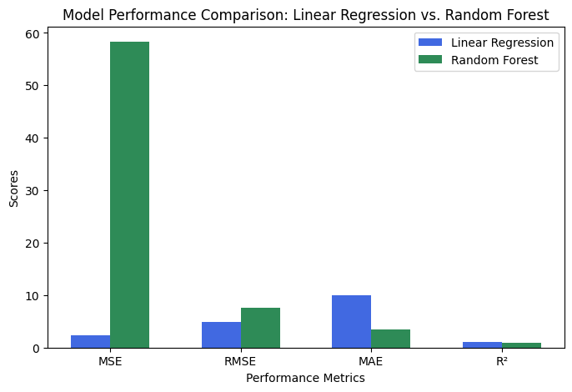
Performance Metrics:
Model: Linear Regression
Mean Absolute Error: 9.9145498
Mean Squared Error: 2.348237
Root Mean Squared Error(RMSE): 4.84586
R-squared Score: 1.0
Model: Random Forest
Mean Absolute Error: 3.53465
Mean Squared Error: 58.32208
Root Mean Squared Error(RMSE): 7.636889
R-squared Score: 0.8656387
Key Observations
Linear Regression performed exceptionally well, achieving an R² score of 1.0, meaning it perfectly fits the data.
The errors (MSE, RMSE, MAE) for Linear Regression are extremely small, almost negligible.
Random Forest had higher errors (MSE = 58.32, RMSE = 7.63), but still maintained a strong R² score of 0.87, indicating a good fit.
Random Forest shows slightly more flexibility in capturing non-linearity but at the cost of higher error.

Slide 14
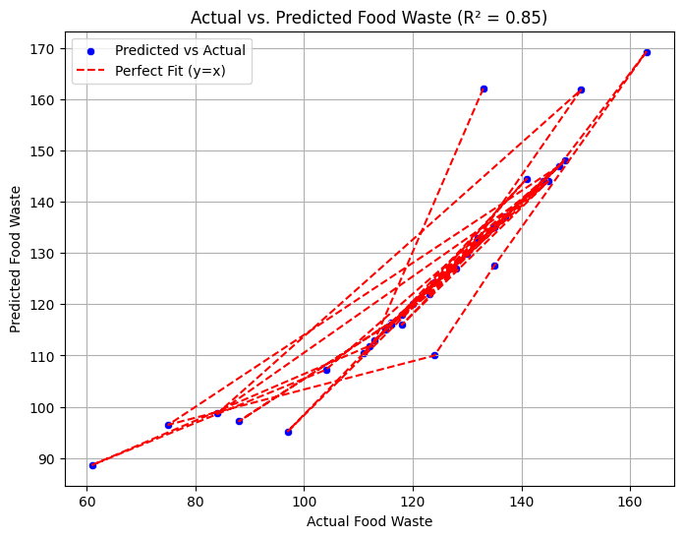
Model Predictions & Deployment
A. Model Predictions vs Actual Data
B. Model Deployment Approach
Flask API for real-time predictions.
Deployment on cloud for accessibility.

Slide 15
Key Findings & Insights
Analysis Area | Key Insight
Top Food Waste Contributors | USA, China, India, Brazil have highest waste
Sector with Highest Waste | Households contribute the most
Correlation Trends | Retail & household food waste are highly correlated
Outliers | Extreme values found in few countries
Best Model | Random Forest performed best for prediction
Household waste is the highest contributor to total food waste globally.
The Food Service sector and Retail sector contribute significantly but are much lower than household waste.
There is regional variation, with some countries generating significantly more waste.
Data confidence varies, affecting the reliability of some estimates.

Slide 16
Conclusion
Findings:
Households contribute the highest to food waste, followed by food services and retail.
Machine Learning can effectively predict food waste, aiding in decision-making.
🔹 Impact & Recommendations:
Implement awareness programs for reducing household waste.
Use ML models for real-time tracking and prediction of food waste.
Governments & businesses can adopt data-driven waste reduction policies.
🔹 Future Scope:
Extend the dataset for more accurate predictions.
Deploy the model into a real-world food waste monitoring system.
Incorporate deep learning for improved accuracy.
Impact & Recommendations
Governments and organizations should focus on reducing household food waste through awareness programs.
Real-time tracking and ML-based forecasting can help businesses manage supply chains better.
Data-driven policies should be implemented to optimize food production and reduce environmental impact.

Slide 17

Conclusion & Future Scope
Final Takeaways:
Food waste is a global issue, mainly from households.
Retail waste is driven by overproduction & disposal practices.
Machine Learning helps predict food waste efficiently.
Future Enhancements:
✅ Time-series forecasting for future trends. ✅ Policy impact analysis on food waste reduction. ✅ Advanced deep learning models for predictions.

Slide 18
References
https://ieeexplore.ieee.org/document/10417963
https://www.fao.org/sustainable-development-goals-data-portal/data/
https://www.unep.org/resources/report/unep-food-waste-index-report-2021

Slide 19
Thank You
Notes:
Thank You !!

